Slide 1
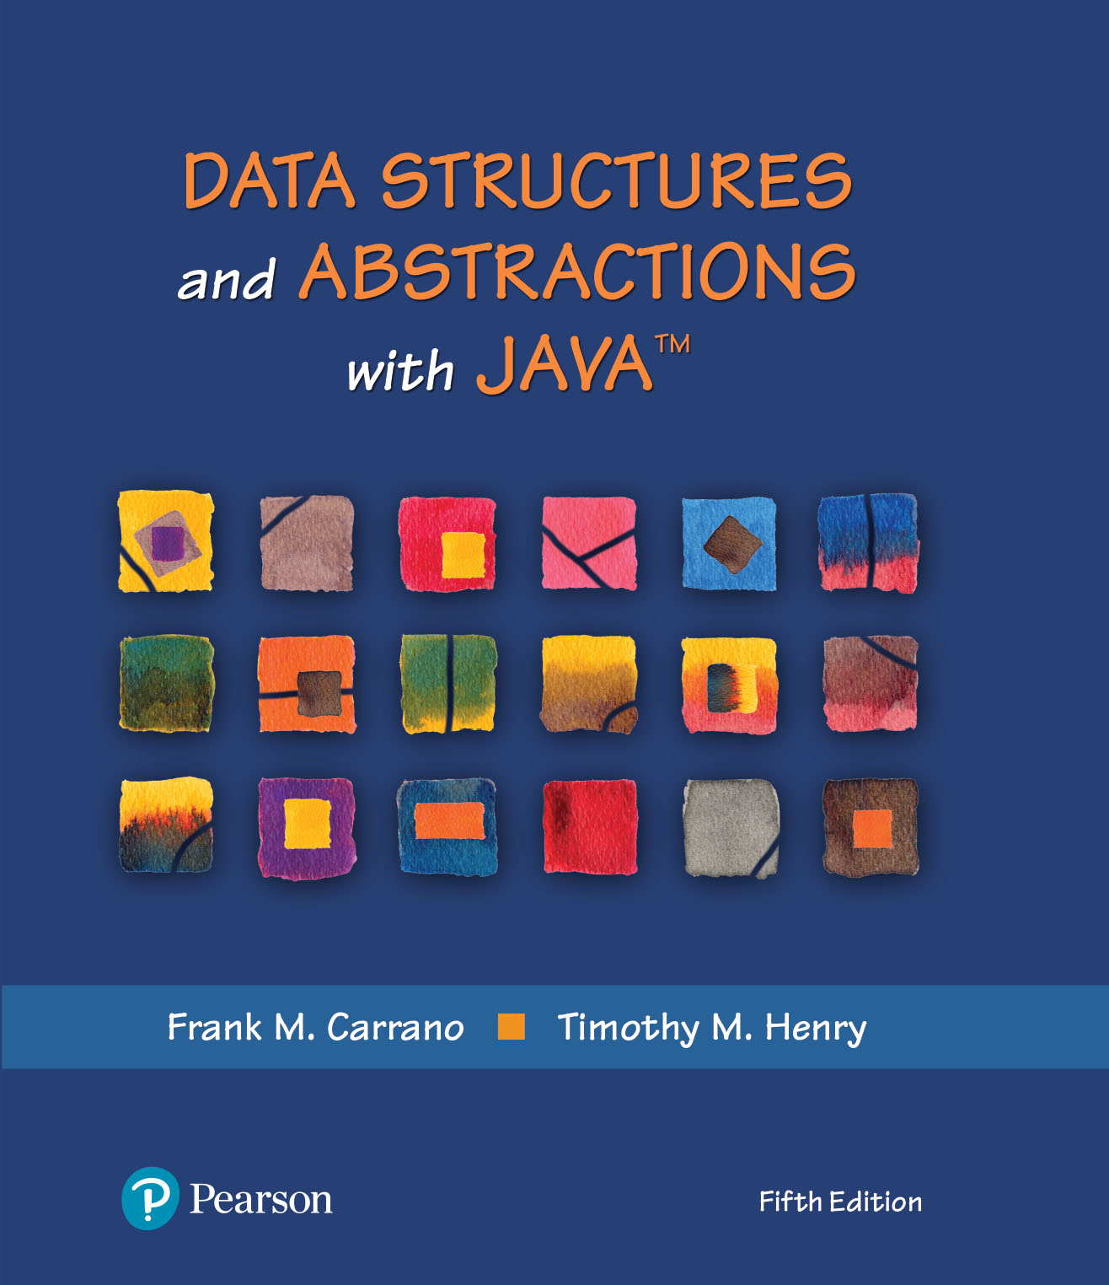
Data Structures and Abstractions with Java™
5th Edition
Module 16 – Sets and Maps

Slide 2
Module 11
Main topics:
Sets
Maps

Slide 3
Sets
Set: Unordered collection of distinct elements
Elements can be added, located, and removed
Sets don’t have duplicates

Slide 4
Fundamental Operations on a Set
Adding an element
Adding an element has no effect if the element is already in the set
Removing an element
Attempting to remove an element that isn’t in the set is silently ignored
Containment testing (Does the set contain a given object?)
Listing all elements (in arbitrary order)

Slide 5
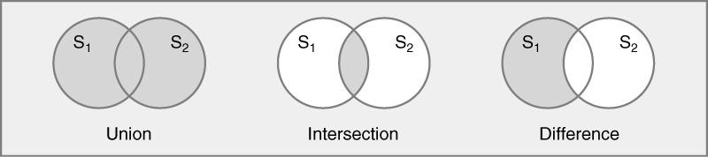
Venn Diagram of three basic set Operations
The shaded area represents:
S₁ S₂
S₁ ∩ S₂
S₁ - S₂
∩

Slide 6
Implementing Sets
There are two ways to implement sets:
Explicit implementation (Bit vector)
Each item in the base type has a representation in each instance of a set.
The representation is either true (item is in the set) or false (item is not in the set).
Space is proportional to the cardinality of the base type (all bit vectors use same amount of memory regardless of number of elements).
Algorithms use Boolean operations.

Slide 7
Explicit implementation
Array-based implementation of bit vector:
Base type is uppercase letters - could be represented with an array with 26 elements in it. [0] represents ‘A’
If setA has the following elements:
(A, D, K, M, P, R, T, V, X, Z)
setA
A | B | C | D | E | F | G | H | I | J | K | L | M | N | O | P | Q | R | S | T | U | V | W | X | Y | Z
1 | 0 | 0 | 1 | 0 | 0 | 0 | 0 | 0 | 0 | 1 | 0 | 1 | 0 | 0 | 1 | 0 | 1 | 0 | 1 | 0 | 1 | 0 | 1 | 0 | 1
If setB has the following elements:
(A, C, E, G, I, L, M, O, Q, T, U, W, Z)
setB
A | B | C | D | E | F | G | H | I | J | K | L | M | N | O | P | Q | R | S | T | U | V | W | X | Y | Z
1 | 0 | 1 | 0 | 1 | 0 | 1 | 0 | 1 | 0 | 0 | 1 | 1 | 0 | 1 | 0 | 1 | 0 | 0 | 1 | 1 | 0 | 1 | 0 | 0 | 1
* of course would not work with infinite base types or large base types

Slide 8
Union, Intersection,Difference
A | B | C | D | E | F | G | H | I | J | K | L | M | N | O | P | Q | R | S | T | U | V | W | X | Y | Z
1 | 0 | 0 | 1 | 0 | 0 | 0 | 0 | 0 | 0 | 1 | 0 | 1 | 0 | 0 | 1 | 0 | 1 | 0 | 1 | 0 | 1 | 0 | 1 | 0 | 1
setA
A | B | C | D | E | F | G | H | I | J | K | L | M | N | O | P | Q | R | S | T | U | V | W | X | Y | Z
1 | 0 | 1 | 0 | 1 | 0 | 1 | 0 | 1 | 0 | 0 | 1 | 1 | 0 | 1 | 0 | 1 | 0 | 0 | 1 | 1 | 0 | 1 | 0 | 0 | 1
setB
Union
A | B | C | D | E | F | G | H | I | J | K | L | M | N | O | P | Q | R | S | T | U | V | W | X | Y | Z
1 | 0 | 1 | 1 | 1 | 0 | 1 | 0 | 1 | 0 | 1 | 1 | 1 | 0 | 1 | 1 | 1 | 1 | 0 | 1 | 1 | 1 | 1 | 1 | 0 | 1
setA U setB
resultvector
Intersection
A | B | C | D | E | F | G | H | I | J | K | L | M | N | O | P | Q | R | S | T | U | V | W | X | Y | Z
1 | 0 | 0 | 0 | 0 | 0 | 0 | 0 | 0 | 0 | 0 | 0 | 1 | 0 | 0 | 0 | 0 | 0 | 0 | 1 | 0 | 0 | 0 | 0 | 0 | 1
setA setB
resultvector
U
Difference
A | B | C | D | E | F | G | H | I | J | K | L | M | N | O | P | Q | R | S | T | U | V | W | X | Y | Z
0 | 0 | 0 | 1 | 0 | 0 | 0 | 0 | 0 | 0 | 1 | 0 | 0 | 0 | 0 | 1 | 0 | 1 | 0 | 0 | 0 | 1 | 0 | 1 | 0 | 0
setA - setB
resultvector

Slide 9
Implementing Sets
Implicit implementation (Sorted List)
The items in an instance of a set are on a list
that represents the set.
Those items that are not on the list are not in the set.
Space is proportional to the cardinality of the
set instance (small sets use less memory than large sets).
Algorithms use List operations.

Slide 10
Implicit implementation
If setB has the following elements:
(A, C, E, G, I, L, M, O, Q, T, U, W, Z)
If setA has the following elements:
(A, D, G, K, M, P, R, T, V, X, Z)
A
C
E
G
I
L
M
O
Q
T
U
W
Z
setA
setB
A
D
G
K
M
P
R
V
X
Z

Slide 11
Implicit implementation
Union
setA U setB
result.items
setB
A
C
D
E
G
I
K
L
M
P
Q
R
T
U
W
X
Z
curposRes
A
C
E
G
I
L
M
O
Q
T
U
W
Z
curposB
setA
curposRes
curposB
curposRes
A
D
G
K
M
P
R
V
X
Z
curposB
curposA
curposB
curposRes
curposA
curposA
curposB
curposRes
curposA
curposA
curposB
curposRes
curposA
curposA
curposRes
curposB

Slide 12
Implicit implementation
Intersection
setA setB
U
setA.items
setB.items
result.items
A
D
G
K
M
P
R
T
V
X
Z
A
C
E
G
I
L
M
O
Q
T
U
W
Z
A
G
M
T
Z

Slide 13
Implicit implementation
Difference
setA - setB
setA.items
setB.items
result.items
A
D
G
K
M
P
R
T
V
X
Z
A
C
E
G
I
L
M
O
Q
T
U
W
Z
D
K
P
R
V
X

Slide 14
Sets
Complexity (average case)
Implicit Explicit
add O(n) O(1)
remove O(n) O(1)
union O(n²) unorderd O(n)
O(n) ordered
intersection O(n²) unordered O(n)
O(n) ordered
difference O(n²) unordered O(n)
O(n) ordered
isEmpty O(1) O(n)
contains O(n) O(1)
subset O(n²) O(n)

Slide 15
Sets
We could use a linked list to implement a set
Adding, removing, and containment testing would be relatively slow
There are data structures that can handle these operations much more quickly
Hash tables
Trees

Slide 16
Sets
Standard Java library provides set implementations based on both data structures
HashSet
TreeSet
Both of these data structures implement the Set interface
As a rule of thumb, use a hash set unless you want to visit the set elements in sorted order

Slide 17
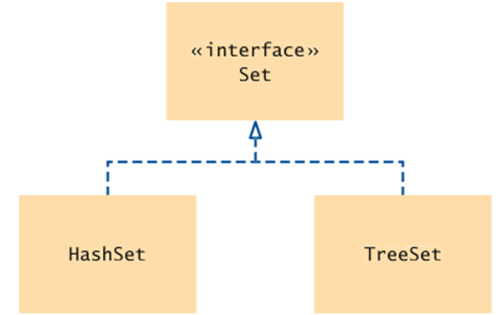
Set Classes and Interface in the Standard Library

Slide 18
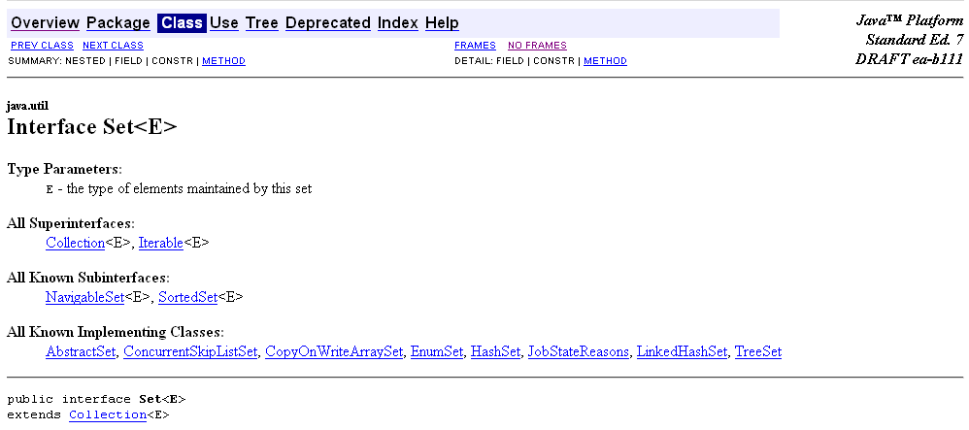
A collection that contains no duplicate elements. More formally, sets contain no pair of elements e1 and e2 such that e1.equals(e2), and at most one null element. As implied by its name, this interface models the mathematical set abstraction.
The Set interface places additional stipulations, beyond those inherited from the Collection interface, on the contracts of all constructors and on the contracts of the add, equals and hashCode methods. Declarations for other inherited methods are also included here for convenience. (The specifications accompanying these declarations have been tailored to the Set interface, but they do not contain any additional stipulations.)
The additional stipulation on constructors is, not surprisingly, that all constructors must create a set that contains no duplicate elements (as defined above).
Note: Great care must be exercised if mutable objects are used as set elements. The behavior of a set is not specified if the value of an object is changed in a manner that affects equals comparisons while the object is an element in the set. A special case of this prohibition is that it is not permissible for a set to contain itself as an element.

Slide 19
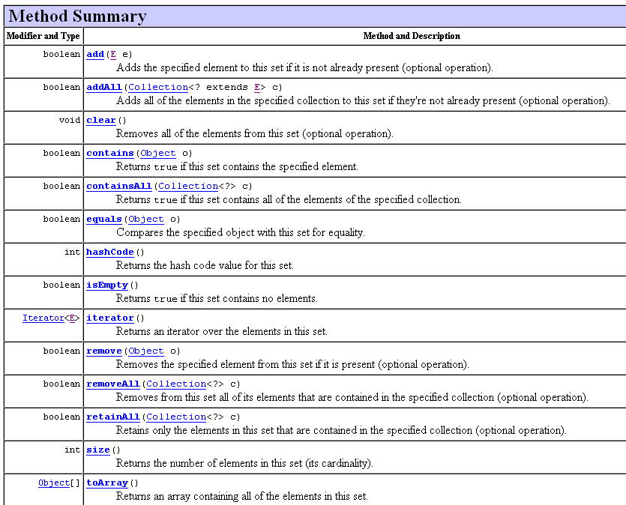

Slide 20
Using a Set
Example: Using a set of strings
Construct the Set:
Set<String> names = new HashSet<String>();
or
Set<String> names = new TreeSet<String>();
Add and remove elements:
names.add("Romeo");
names.remove("Juliet");
Test whether an element is contained in the set:
if (names.contains("Juliet")) . . .

Slide 21
Iterator
Use an iterator to visit all elements in a set
A set iterator does not visit the elements in the order in which they were inserted
An element cannot be added to a set at an iterator position
A set element can be removed at an iterator position

Slide 22
Visiting All Elements with an Iterator
Iterator<String> iter = names.iterator(); while (iter.hasNext()) { String name = iter.next(); Do something with name }
or, using the “for each” loop:
for (String name : names) { Do something with name }

Slide 23
Set Test Program
Read in all words from a dictionary ﬁle that contains correctly spelled words and place them into a set
Read all words from a document into a second set — here, the book “Alice in Wonderland”
Print all words from that set that are not in the dictionary set — potential misspellings

Slide 24
1 import java.util.HashSet;
2 import java.util.Scanner;
3 import java.util.Set;
4 import java.io.File;
5 import java.io.FileNotFoundException;
6
7 /**
8 This program checks which words in a file are not present in a dictionary.
9 */
10 public class SpellCheck
11 {
12 public static void main(String[] args)
13 throws FileNotFoundException
14 {
15 // Read the dictionary and the document
16
17 Set<String> dictionaryWords = readWords("words");
18 Set<String> documentWords = readWords("alice30.txt");
19

Slide 25
15 // Read the dictionary and the document
16
17 Set<String> dictionaryWords = readWords("words");
18 Set<String> documentWords = readWords("alice30.txt");
19
20 // Print all words that are in the document but not the dictionary
21
22 for (String word : documentWords)
23 {
24 if (!dictionaryWords.contains(word))
25 {
26 System.out.println(word);
27 }
28 }
29 }
30

Slide 26
31 /**
32 Reads all words from a file.
33 @param filename the name of the file
34 @return a set with all lowercased words in the file. Here, a
35 word is a sequence of upper- and lowercase letters.
36 */
37 public static Set<String> readWords(String filename)
38 throws FileNotFoundException
39 {
40 Set<String> words = new HashSet<String>();
41 Scanner in = new Scanner(new File(filename));
42 // Use any characters other than a-z or A-Z as delimiters
43 in.useDelimiter("[^a-zA-Z]+");
44 while (in.hasNext())
45 {
46 words.add(in.next().toLowerCase());
47 }
48 return words;
49 }
50 }

Slide 27
Something to consider
Arrays and lists remember the order in which you added elements; sets do not. Why would you want to use a set instead of an array or list?
Answer: Efficient set implementations can quickly test whether a given element is a member of the set. Can do unions, intersections and differences.

Slide 28
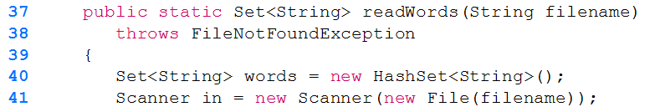
Something to consider
Suppose you changed line 40 of the SpellCheck program to use a TreeSet instead of a HashSet. How would the output change?
Answer: The words would be listed in sorted order, based on the natural ordering for the objects, in this case Strings.

Slide 29
Set Interface Bulk Operations
Bulk operations are particularly well suited to Sets; when applied, they perform standard set-algebraic operations. Suppose s1 and s2 are sets. Here's what bulk operations do:
s1.containsAll(s2) — returns true if s2 is a subset of s1. (s2 is a subset of s1 if
set s1 contains all of the elements in s2.)
s1.addAll(s2) — transforms s1 into the union of s1 and s2. (The union of two sets is the set containing all of the elements contained in either set.)
s1.retainAll(s2) — transforms s1 into the intersection of s1 and s2. (The intersection of two sets is the set containing only the elements common to both sets.)
s1.removeAll(s2) — transforms s1 into the (asymmetric) set difference of s1 and s2. (For example, the set difference of s1 minus s2 is the set containing all of the elements found in s1 but not in s2.)

Slide 31
To calculate the union, intersection, or set difference of two sets nondestructively (without modifying either set), the caller must copy one set before calling the appropriate bulk operation. The following are the resulting idioms.
Set<Type> union = new HashSet<Type>(s1);
union.addAll(s2);
Set<Type> intersection = new HashSet<Type>(s1); intersection.retainAll(s2);
Set<Type> difference = new HashSet<Type>(s1);
difference.removeAll(s2);

Slide 32
Maps
A map keeps associations between key and value objects
Mathematically speaking, a map is a function from one set, the key set, to another set, the value set
Every key in a map has a unique value
A value may be associated with several keys
Classes that implement the Map interface
HashMap
TreeMap
Both of these data structures implement the Map interface
As a rule of thumb, use a hash map unless you want to visit the set elements in sorted order

Slide 33
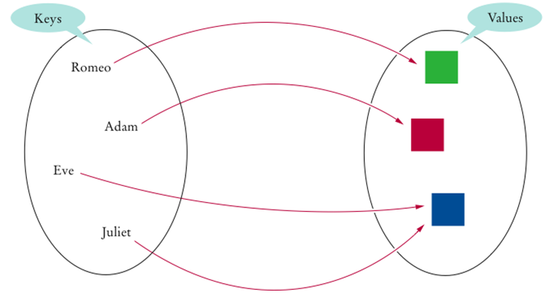
An Example of a Map

Slide 34
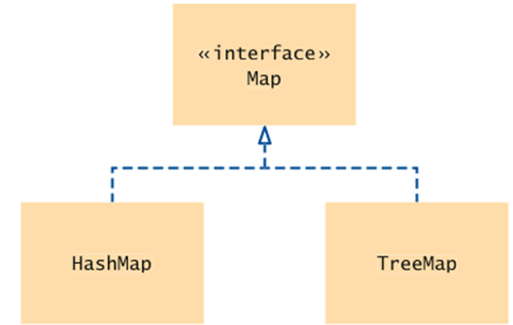
Map Classes and Interfaces

Slide 35
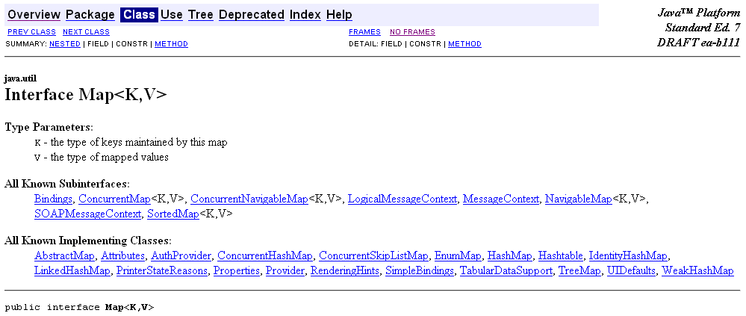
An object that maps keys to values. A map cannot contain duplicate keys; each key can map to at most one value.
This interface takes the place of the Dictionary class, which was a totally abstract class rather than an interface.
The Map interface provides three collection views, which allow a map's contents to be viewed as a set of keys, collection of values, or set of key-value mappings. The order of a map is defined as the order in which the iterators on the map's collection views return their elements. Some map implementations, like the TreeMap class, make specific guarantees as to their order; others, like the HashMap class, do not.
Note: great care must be exercised if mutable objects are used as map keys. The behavior of a map is not specified if the value of an object is changed in a manner that affects equals comparisons while the object is a key in the map. A special case of this prohibition is that it is not permissible for a map to contain itself as a key. While it is permissible for a map to contain itself as a value, extreme caution is advised: the equals and hashCode methods are no longer well defined on such a map.

Slide 36
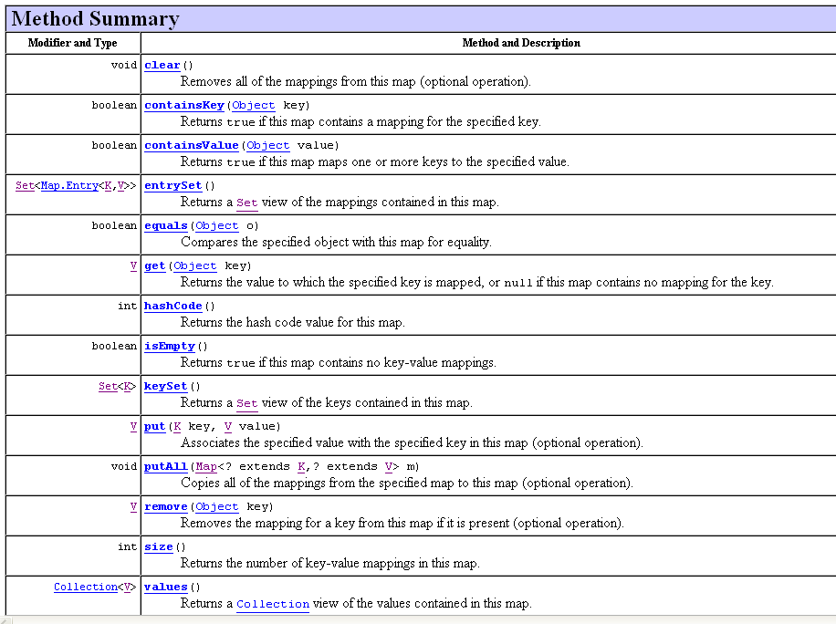

Slide 37
Using a Map
Example: Associate names with colors
Construct the Map:
Map<String, Color> favoriteColors =
new HashMap<String, Color>();
or
Map<String, Color> favoriteColors =
new TreeMap<String, Color>();
Add an association:
favoriteColors.put("Juliet", Color.RED);
Change an existing association:
favoriteColors.put("Juliet",Color.BLUE);

Slide 38
Using a Map
Get the value associated with a key:
Color julietsFavoriteColor =
favoriteColors.get("Juliet”);
Remove a key and its associated value:
favoriteColors.remove("Juliet");

Slide 39
Printing Key/Value Pairs
Set<String> keySet = m.keySet(); for (String key : keySet) { Color value = m.get(key); System.out.println(key + ” : " + value); }

Slide 40
1 import java.awt.Color;
2 import java.util.HashMap;
3 import java.util.Map;
4 import java.util.Set;
5
6 /**
7 This program demonstrates a map that maps names to colors.
8 */
9 public class MapDemo
10 {
11 public static void main(String[] args)
12 {
13 Map<String, Color> favoriteColors = new HashMap<String, Color>();
14 favoriteColors.put("Juliet", Color.BLUE);
15 favoriteColors.put("Romeo", Color.GREEN);
16 favoriteColors.put("Adam", Color.RED);
17 favoriteColors.put("Eve", Color.BLUE);
18

Slide 41
19 // Print all keys and values in the map
20
21 Set<String> keySet = favoriteColors.keySet();
22 for (String key : keySet)
23 {
24 Color value = favoriteColors.get(key);
25 System.out.println(key + " : " + value);
26 }
27 }
28 }
Program Run:
Romeo : java.awt.Color[r=0,g=255,b=0]
Eve : java.awt.Color[r=0,g=0,b=255]
Adam : java.awt.Color[r=255,g=0,b=0]
Juliet : java.awt.Color[r=0,g=0,b=255]
How would the output change if we used a TreeMap?
The keys would be in order

Slide 42
What is the difference between a set and a map?
Answer: A set stores unique elements. A map stores associations between keys and values.

Slide 43
Why is the collection of the keys of a map a set?
Answer: The ordering does not matter, and you cannot have duplicates.

Slide 44
Hash Maps
In a hash map, only the keys are hashed
The keys need compatible hashCode and equals method
If we used Strings as the key, hashcode and equals are already defined.

Slide 45
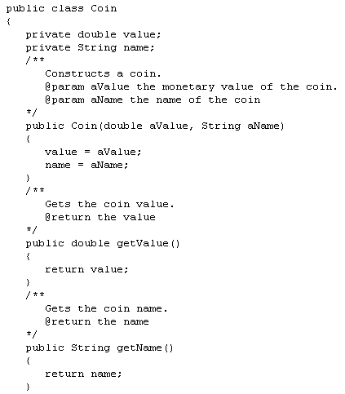
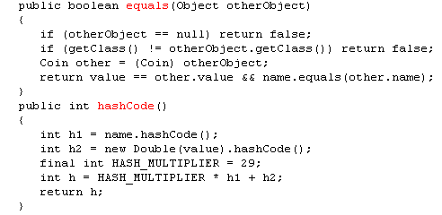


Slide 46
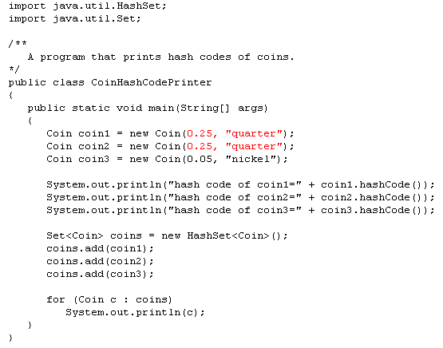
What would be the output from the for each loop?

